Slide 1
Advanced Algorithms for THz Sensing and Recognition
Murat Torlak and Yiorgos Makris
December 7th, 2021 – Review

Slide 2
Updates
Synthetic Data
Representative of real data
Generate new datasets
Real Radar Data
Calibration issues with old data
Improved calibration
Collect larger datasets
Future Work

Slide 3
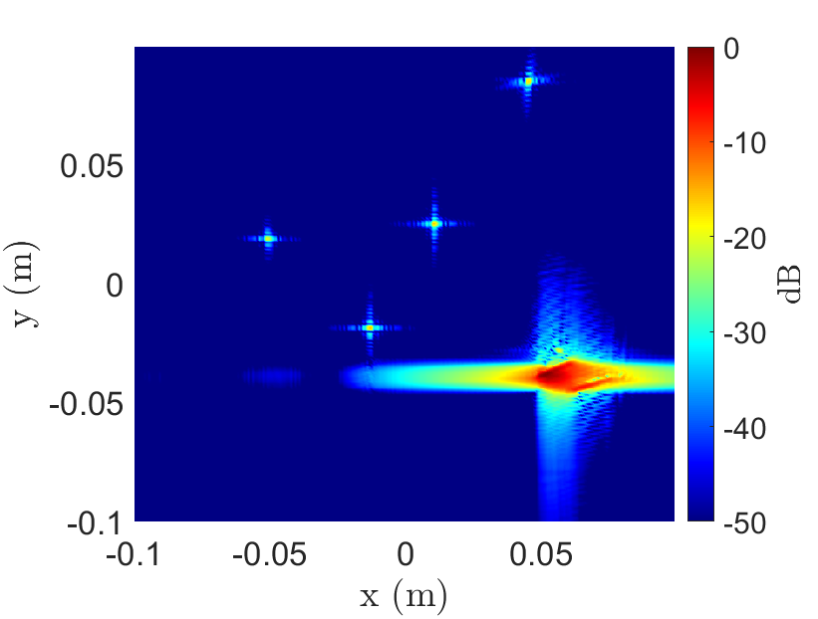
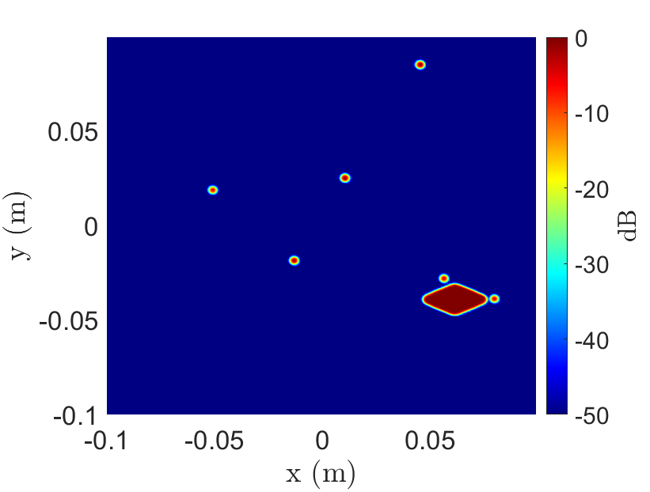
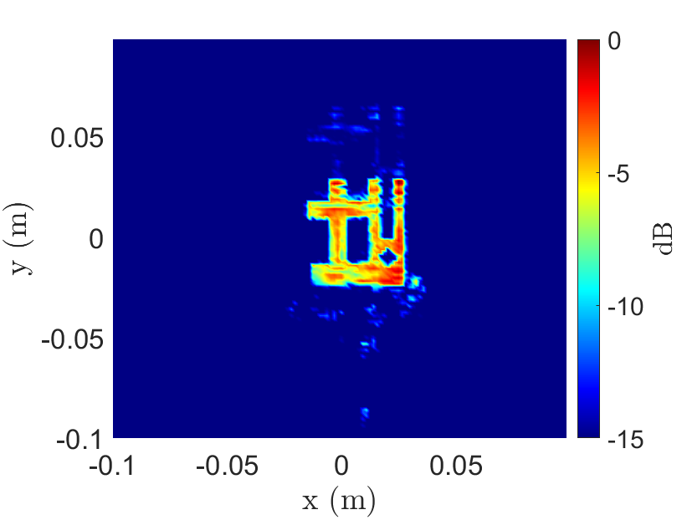
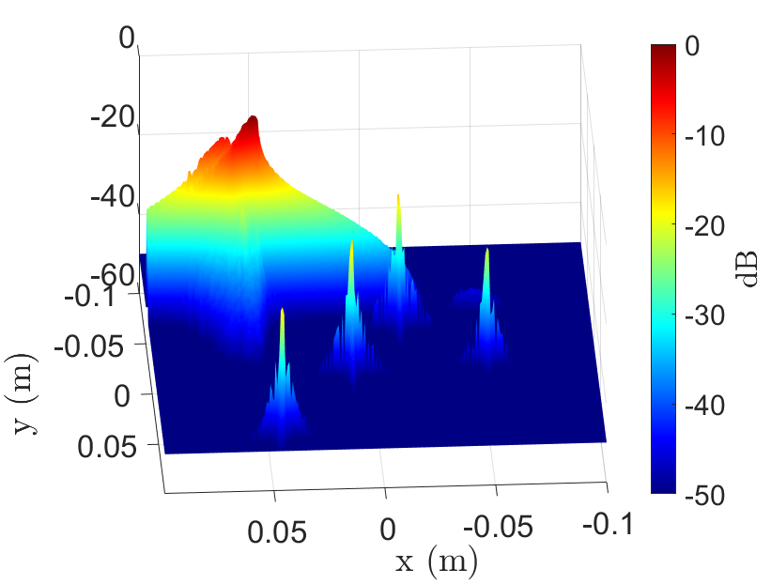
Synthetic Dataset – Old
Old Synthetic Data
Solid, filled targets
Low-power point scatterers
Noiseless
Real Data
Solid targets, with hollow cutouts

Slide 4
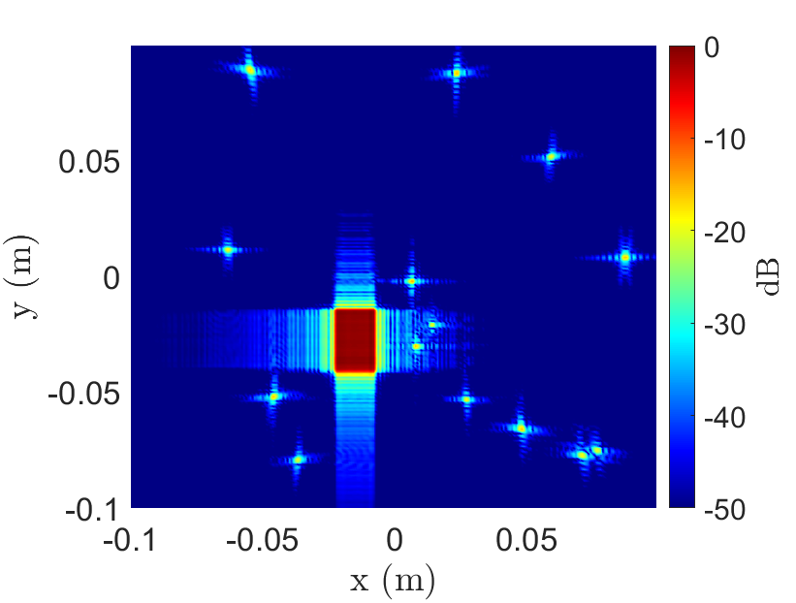
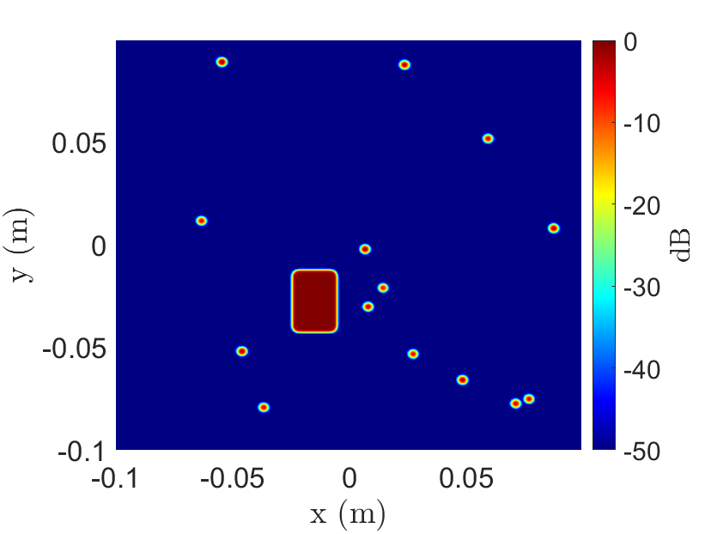
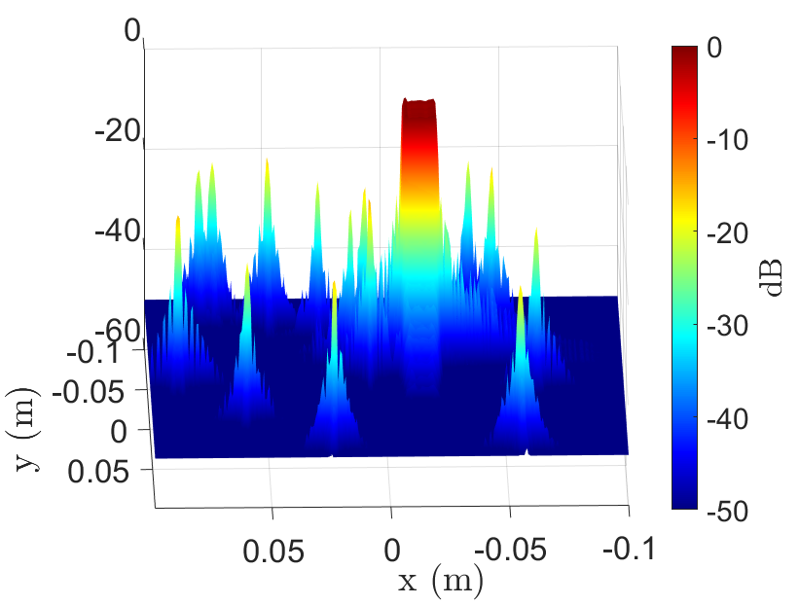
Synthetic Dataset – Old
Old Synthetic Data
Solid, filled targets
Low-power point scatterers
Noiseless
Real Data
Solid targets, with hollow cutouts

Slide 5
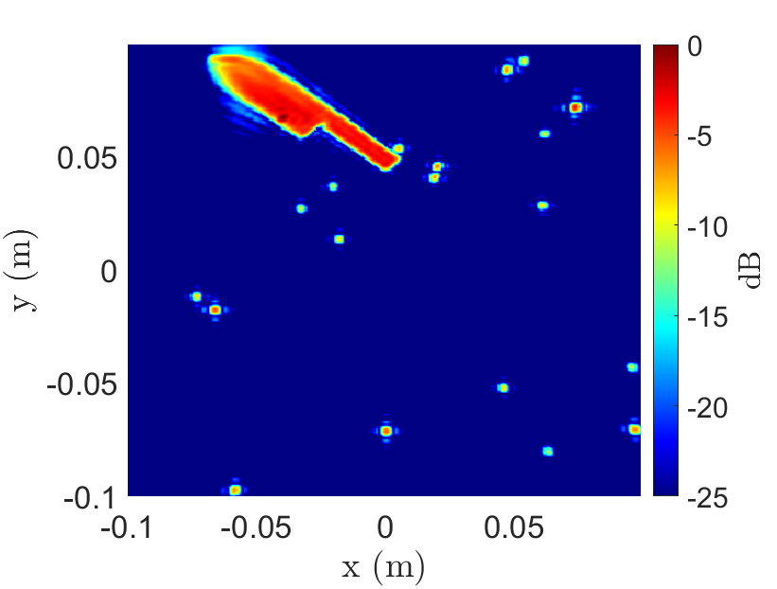
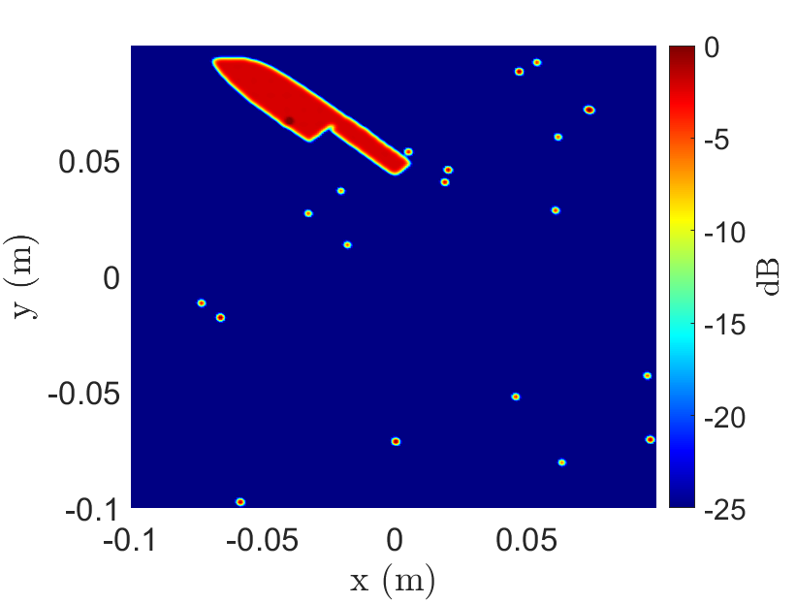
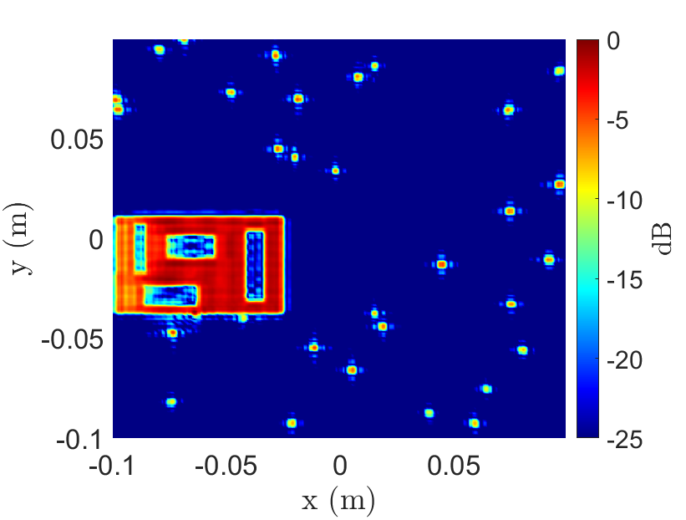
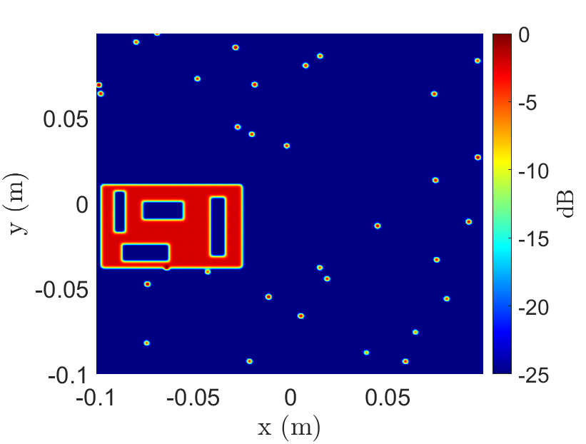
Synthetic Dataset Generation – New
Solid objects
Filled
Hollow
Point scatterers
Close power to solid targets
(Or no point scatterers)
Added noise
Gaussian noise
SNR: 25 – 50 dB

Slide 6
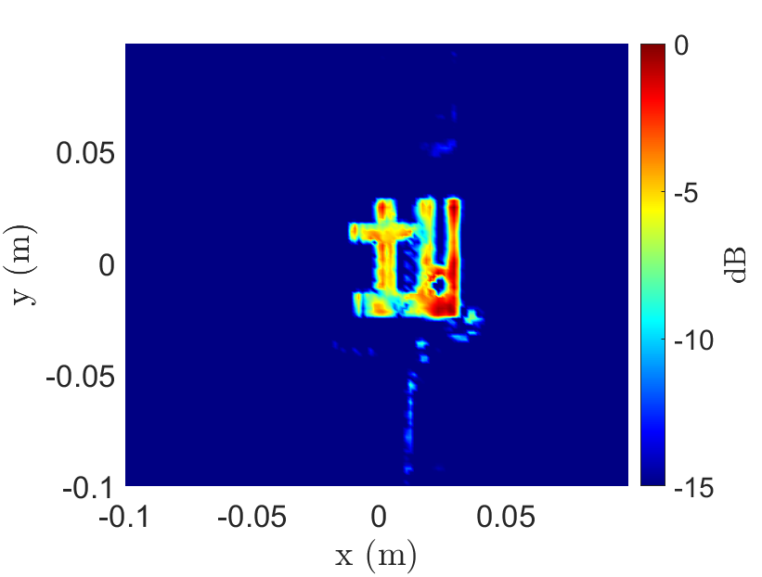
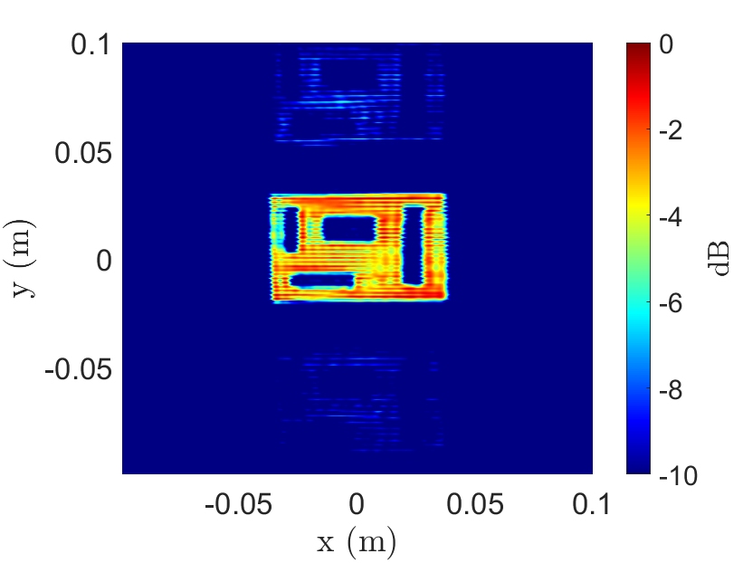
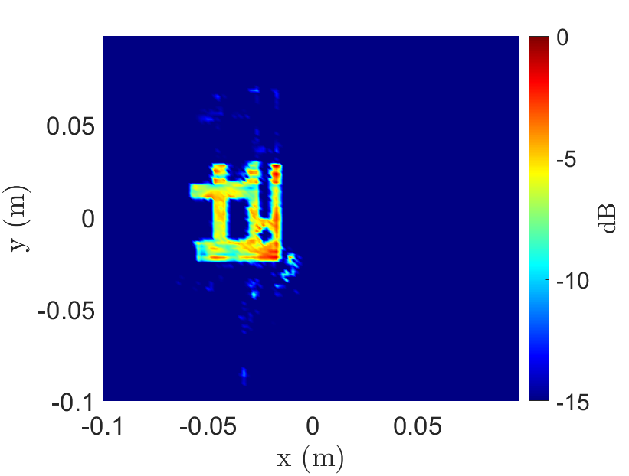
Real Radar Data
Old Radar Data Issues
Inconsistent reflections from solid objects
Horizontal distortion
Improved Calibration
Hardware delay
Device non-linearity
Near-DC noise

Slide 7
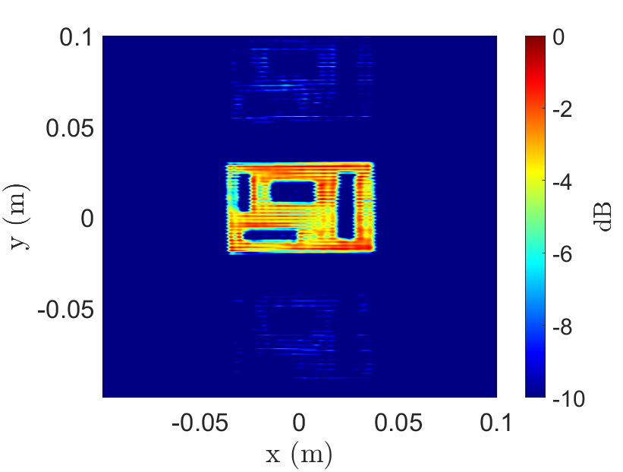
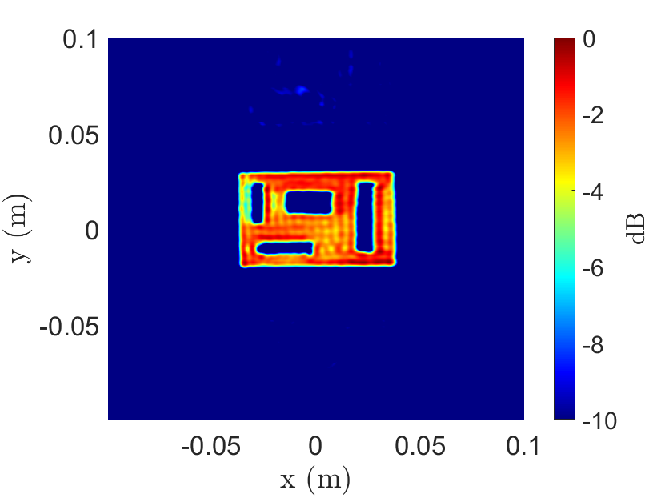
Real Radar Data – New
Improved Calibration Process
Calibrate MIMO array phase
Subtract beat signal from empty scene
Consistent reflection + mitigate horizontal distortion

Slide 8
Future Work
Train network on new synthetic dataset
More representative of real data
Leverage new real data
Improved image quality
Imaging calibration
Collect larger real dataset
Solid targets of various sizes and shapes
Automated data collection

